Slide 1
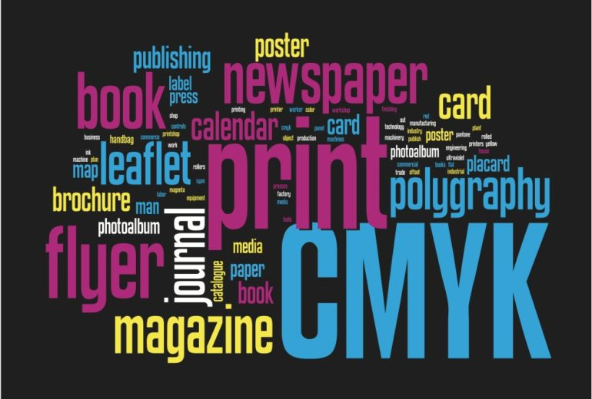

Slide 2


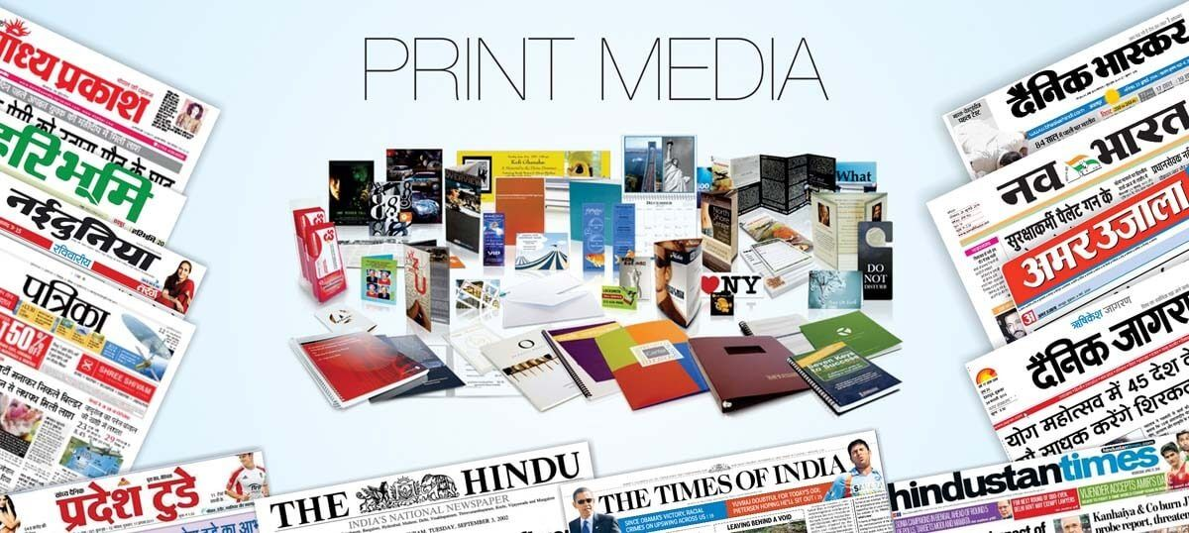
SYMBIOSIS Center for Distance Learning
Print Media Enterprise
Presented By
Rushikesh Chaudhari
Smita Pawar
Guided By- Raj kolhe
Batch- J36

Slide 3
Index
1.Introductiuon
2. Project Objective
3.System Architecture
4.User Management
5.Content Management System
6.Technologies Used
7.Conclusion

Slide 4
Introduction
Importance of a user-friendly advertising platform in the print media industry
Image: A high-quality image showcasing a variety of print media (e.g., magazine with an ad, newspaper spread)
We aim to address the evolving needs of advertisers and readers by offering a user-friendly and efficient solution for promoting products and services through print media enterprises.

Slide 5
Project Objective
The primary objective of our project is to develop a modern and user-friendly print media advertising platform that revolutionizes the way advertisers connect with their target audiences and readers engage with print media content.

Slide 6
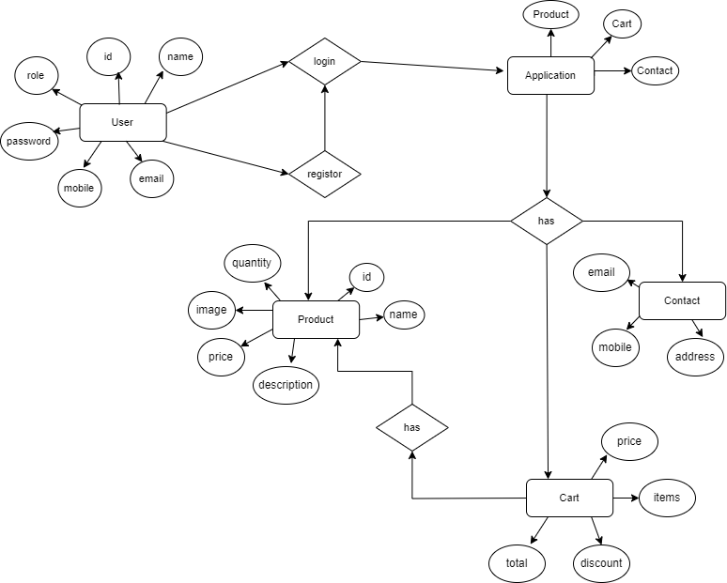
System Architecture
ER Daigram

Slide 7
User Management
Our print media enterprise project incorporates user management functionalities to facilitate seamless interaction and engagement within the platform.
User-friendly registration process allowing individuals to create accounts with minimal effort.
Collection of essential user information while maintaining privacy and security standards.
Seamless integration with payment management and billing processes.

Slide 8
Content Management System
Our print media enterprise project includes a robust Content Management System (CMS) tailored to the specific needs of publishers and advertisers.
The CMS facilitates the creation, editing, and publishing of content, empowering users to efficiently manage their print media campaigns.

Slide 9
Technologies Used
Spring Boot: Chosen for its ease of development, robustness, and extensive ecosystem of libraries and tools for building enterprise-grade applications.
Java: The primary programming language for implementing business logic and backend services.
HTML, CSS, JavaScript: Used for developing the frontend user interface, ensuring a responsive and visually appealing design.
Angular/React (optional): Frontend frameworks that facilitate the development of single-page applications (SPAs) with dynamic user interfaces and enhanced interactivity.

Slide 10
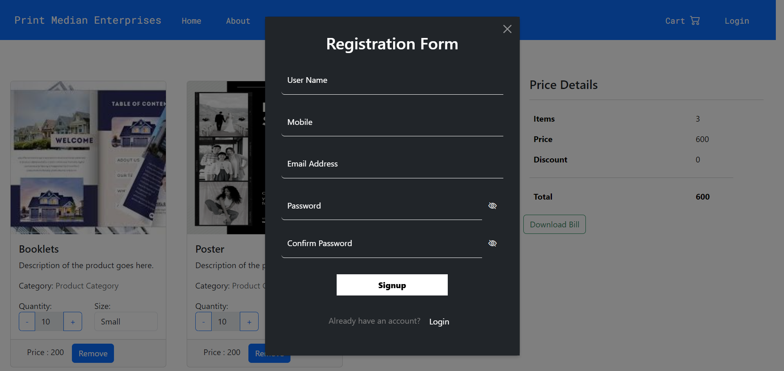

Slide 11
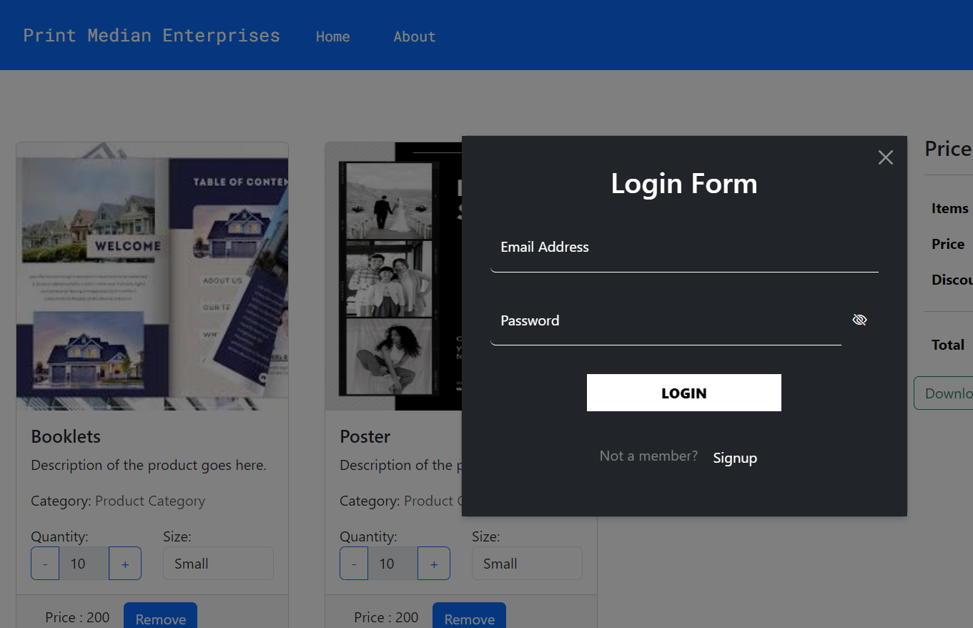

Slide 12
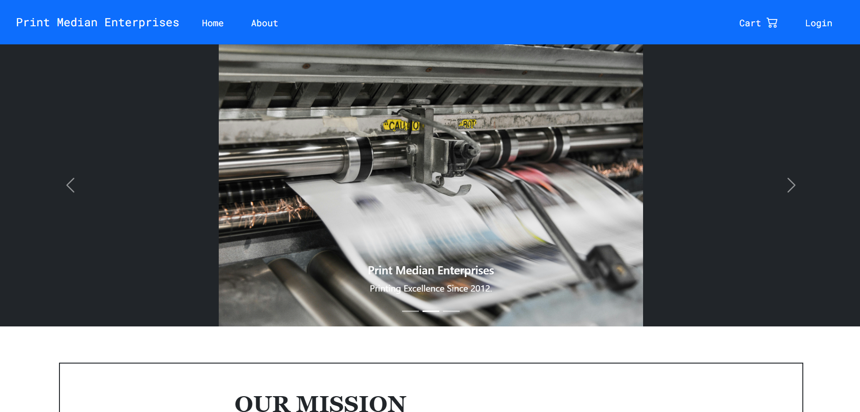

Slide 13
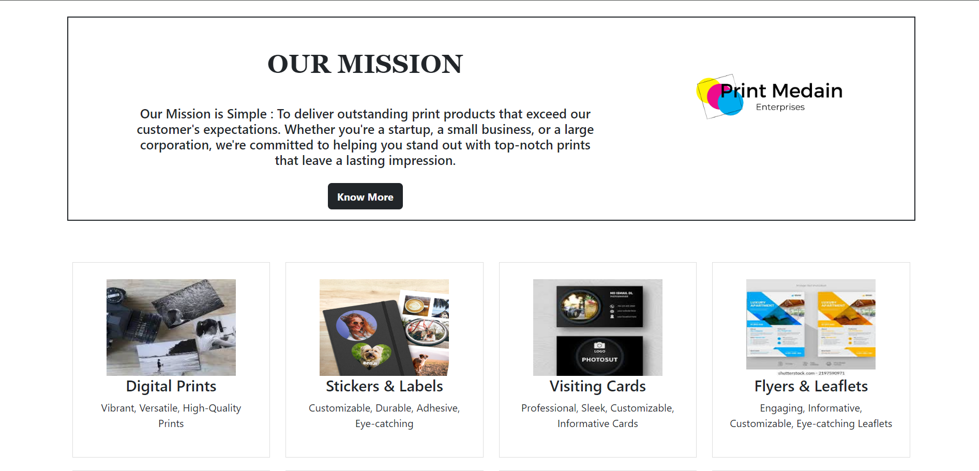

Slide 14
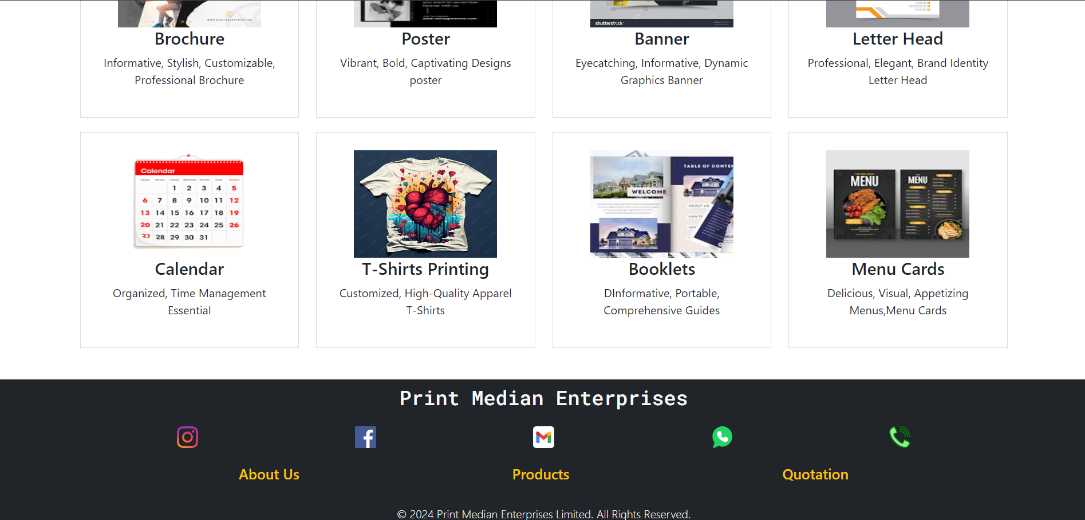

Slide 15
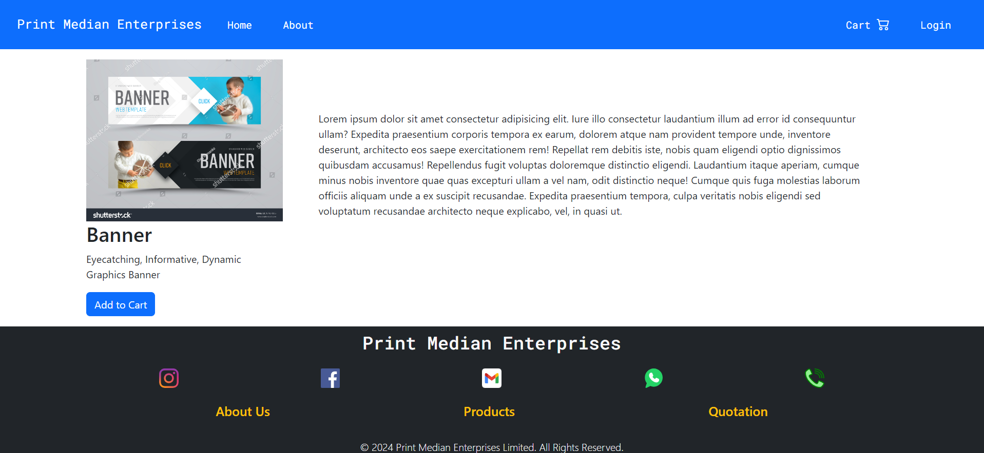

Slide 16
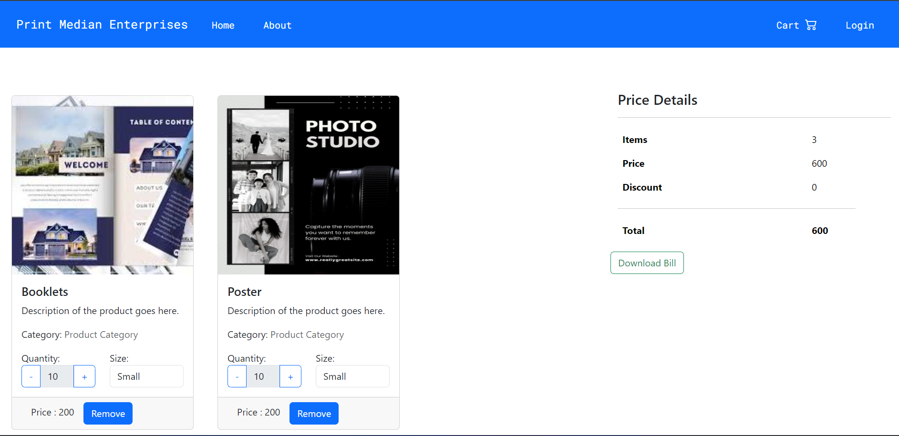

Slide 17
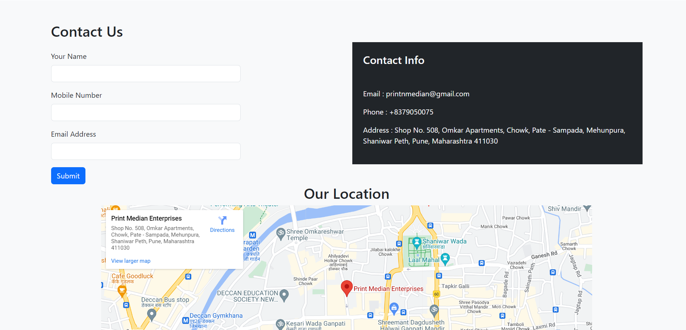

Slide 18
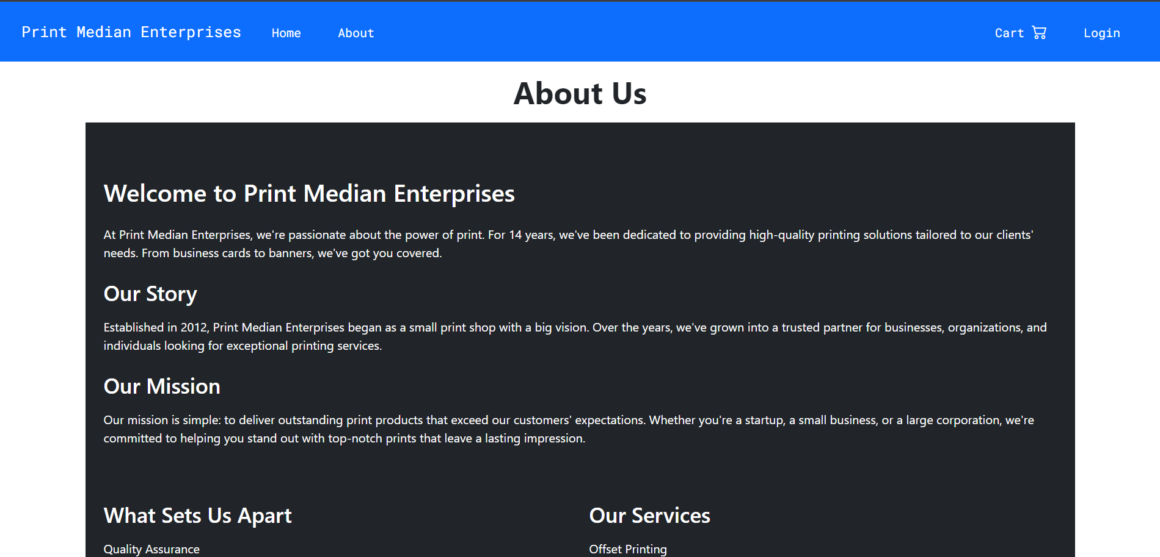

Slide 19
Reference
1.You tube
2.Google
3.Chat gpt
4.W3School
5.Java oracle
6.Java T-Point.

Slide 20
Conclusion
In conclusion, our e-commerce platform for printing products offers a seamless solution for customers to personalize and order their desired items with ease. With a user-friendly interface, diverse product options, and efficient delivery services, we strive to provide a convenient and satisfying printing experience for all our users.

